Slide 1
Mini Project

Slide 2
Mini-project with Copilot
Work on an open-source project issue with the assistance of Work on an open-source project issue with the assistance of GitHub

Slide 3
Survey at the end of the Mini Project
After completing the project you can visit the link below to get the extra credit for participating in studies.
Participation is voluntary

Slide 4
Describe
You will work on a programming problem
Solving an issue on an open-source project
Use Github Copilot to work on solution with help of AI features in Copilot
After completing the task make a pull request
Make submission in canvas (pull request link)
Participate in survey (voluntary, receive extra credit)

Slide 5
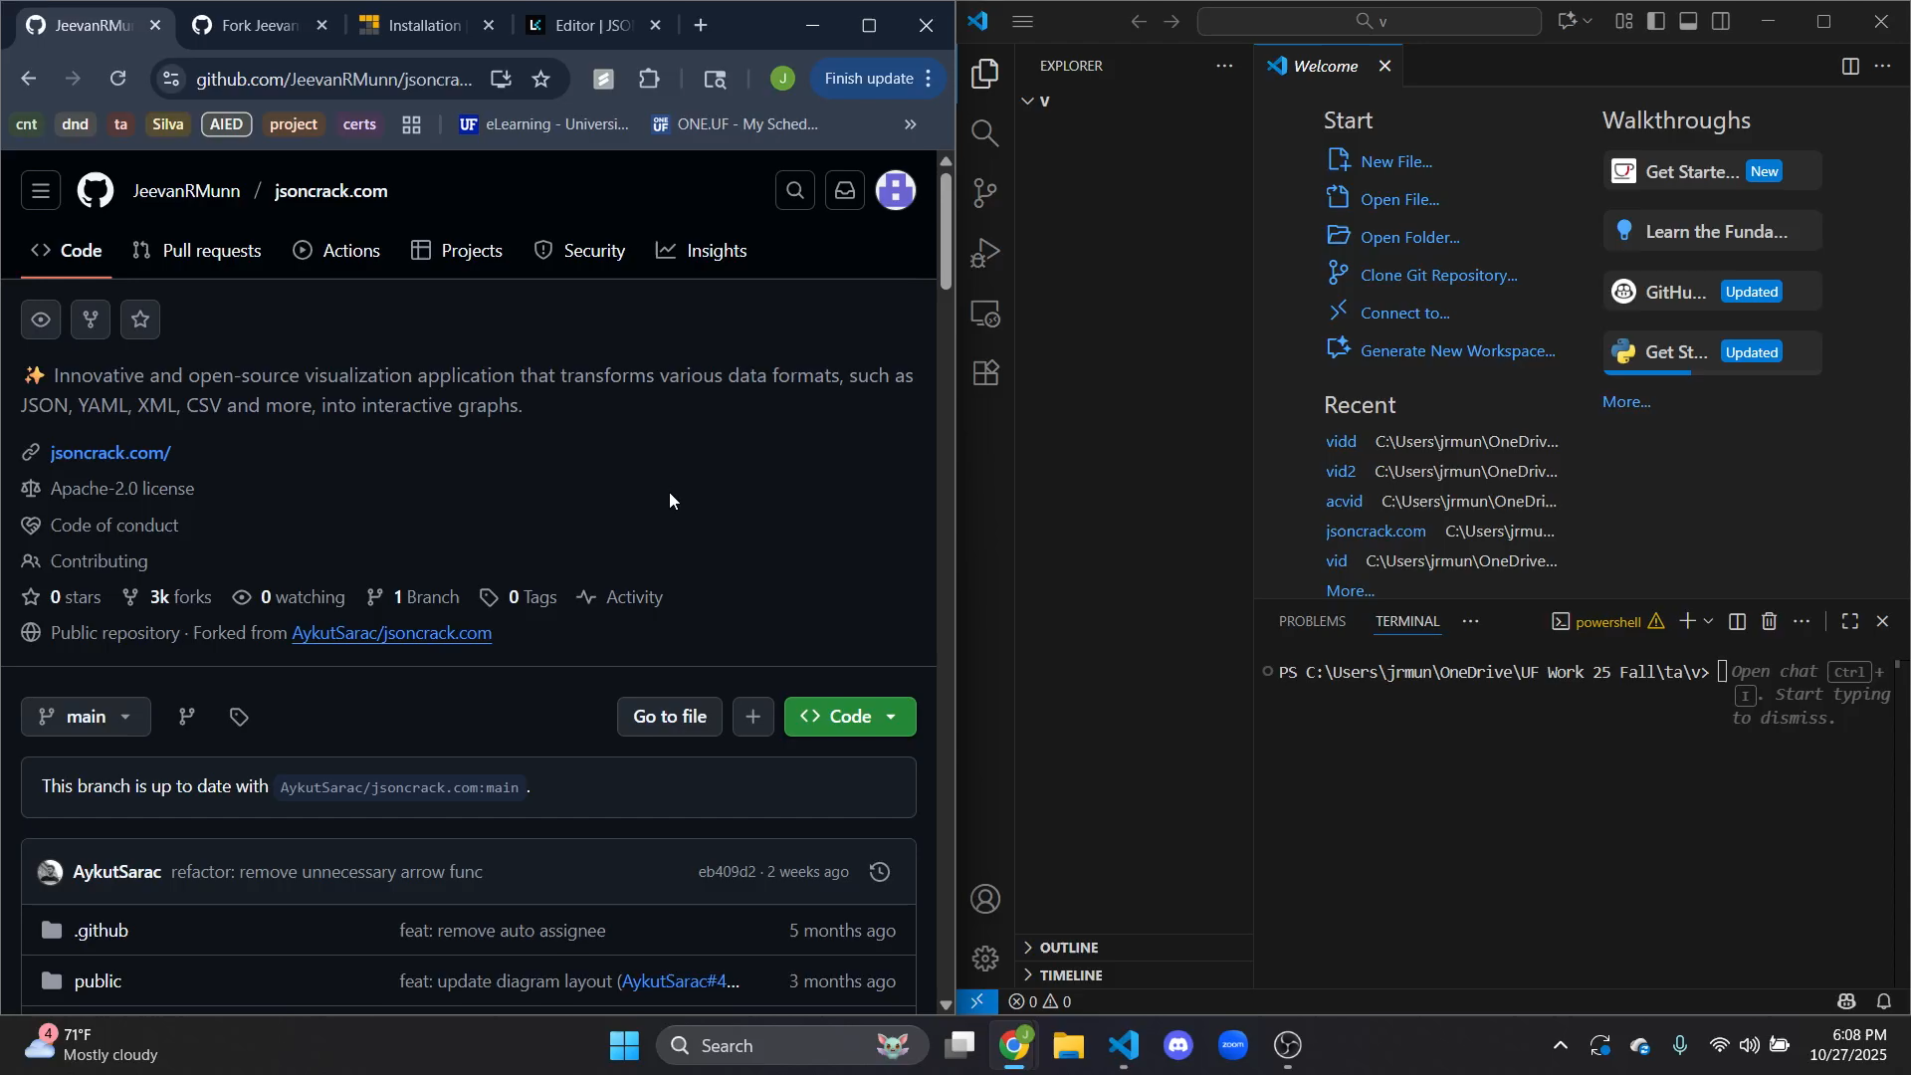
Task

Slide 6
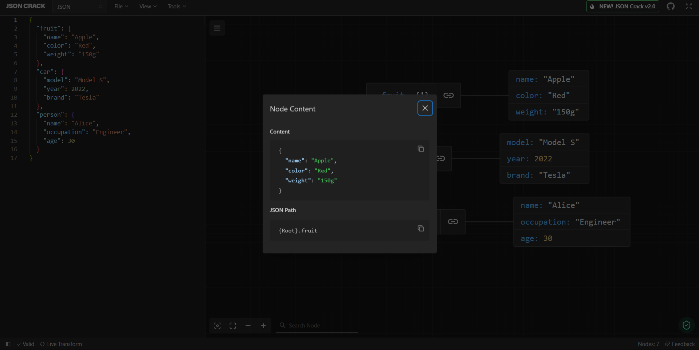
Original View

Slide 7
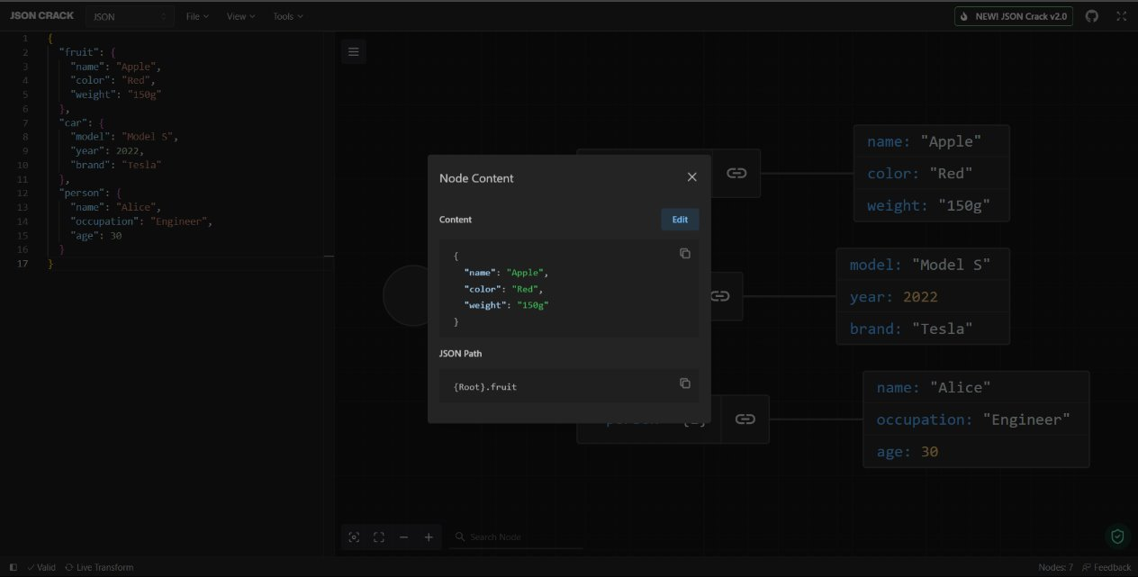
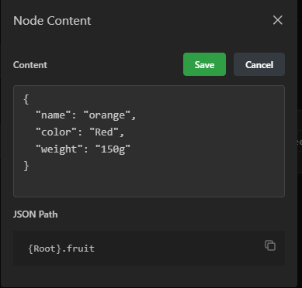
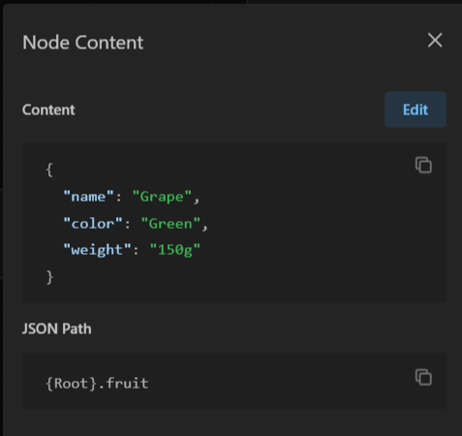
Goal View

Slide 8
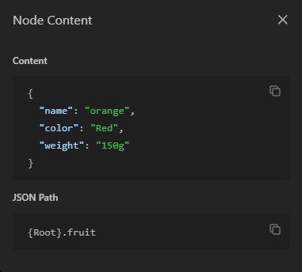
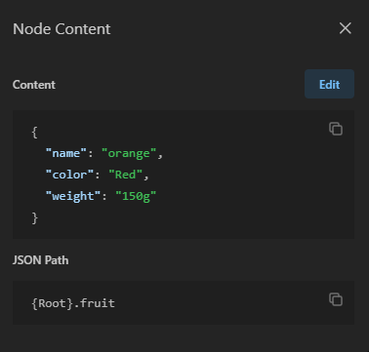
Task
Allow users to edit node values directly from the visualization panel.
Add an edit button to nodes in the visualization
Include save and cancel functionality
Edits should be reflected in
Visualization
Left hand side editor
Notes:
This assignment will be using AykutSarac's JSON visualizer, an open-source repository as the general workspace. Using copilot tools, you will be responsible for the task below.
The task here will be to implement a new feature that allows editing of the data of the node shown in the visualization portion of the screen. As editing the data in the editor on the left-hand side of the screen is more complex with bigger JSON's, you are to implement a feature that allows a user to directly edit a node and change the value of specific content or its label. As can be seen in the images to the left, the label and the value for the JSON can be changed for that node. This change should also be reflected in the left-hand sides text editor and maintain the properties of the JSON from before and contain the edits.

Slide 9
Process
Setup
Fork the repository https://github.com/JeevanRMunn/jsoncrack.com
Git clone <your repo link>
npm install -g pnpm@latest-10
Pnpm install
Pnpm dev
With this, the application will run, but the initial run does take about 5 minutes or so.
Editing
Git add
Git commit –m <message>
Git push origin main
Create pull request to original repository https://github.com/JeevanRMunn/jsoncrack.com.git main branch

Slide 10
Milestones
Edit feature (button/ toggle/ etc) : Front end feature
Enable editing of specific node values : User can edit the values of the node
Save and cancel feature (button/ toggle/ etc) : Front end feature
Proper changes in the visualization of the node : node value stays changed
Proper changes in the text of the editor : Internal data is updated to reflect change in json

Slide 11
Copilot Demo
Copilot offers many diverse uses in Vscode, focused to assist the developer. Copilot does NOT write perfect code, and can make mistakes. Be sure to review code suggestions, and test code before use. The following slides will demonstrate some of the more popular and effective uses of Copilot.
Inline Autocompletion
Direct chat (Top right button next to search bar)
At the end of the session, chat must be exported via CTRL + SHIFT + P (Chat: Export chat)
Comments
AI suggested code completions from comment
CTRL + I
Instant copilot asking capability
/(command) for specific types of responses regarding a highlighted section
Must click show in chat

Slide 12
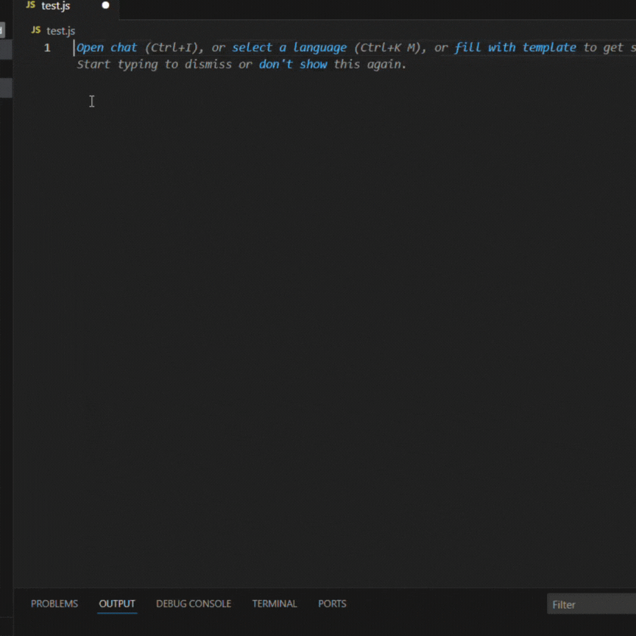
Inline Autocompletion
Inline auto completion is a feature that automatically offers code suggestions as you type, like predictive texts
‘Tab’ to accept, or ‘Ctrl + Space’ to manually trigger a suggestion

Slide 13
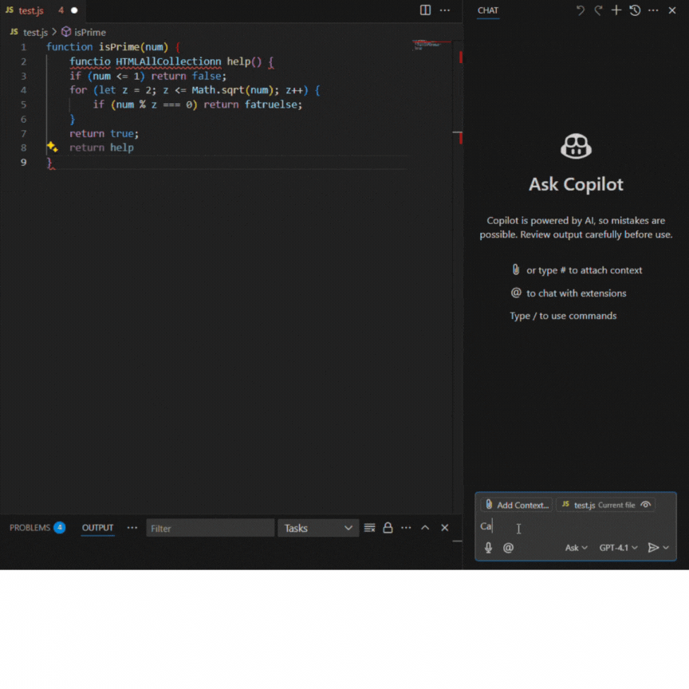

Copilot Chat
From the command palette pick out the copilot chat (Github Copilot icon)
Dedicated assistant, can ask questions in natural language
Can answer any questions, such as “What does this function do” or “How can I optimize this?”
To add context (files to consider) click the "Add Context" button
Make sure to export when you are done with the problem CTRL + SHIFT + P

Slide 14
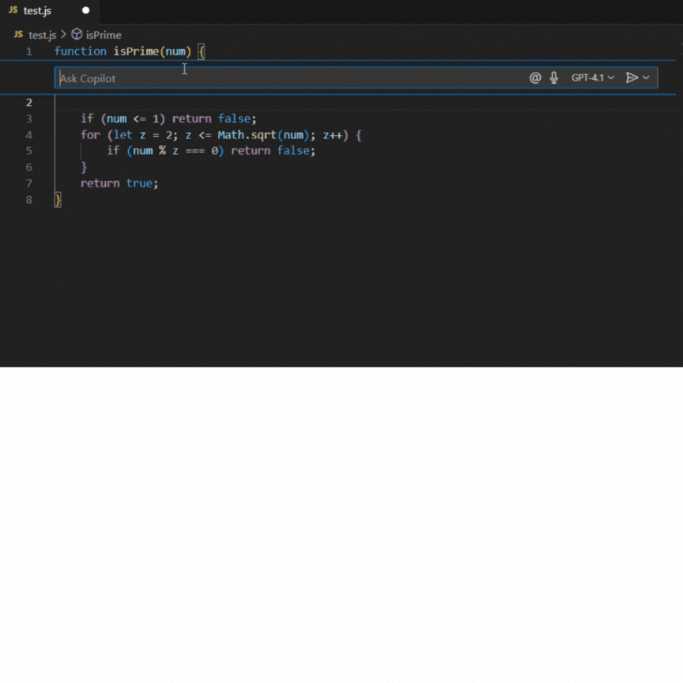
Editor Inline commands
Use ‘Ctrl + i’ to open the inline editor
By using ‘/’ followed by a keyword, copilot will interact with your code
Common uses: /fix, /explain, /doc, etc.
Ex: /explain what the code block does
Highlight particular functions/blocks of code and use the inline editor to focus on particular code snippets
Remember, must click view in chat!

Slide 15
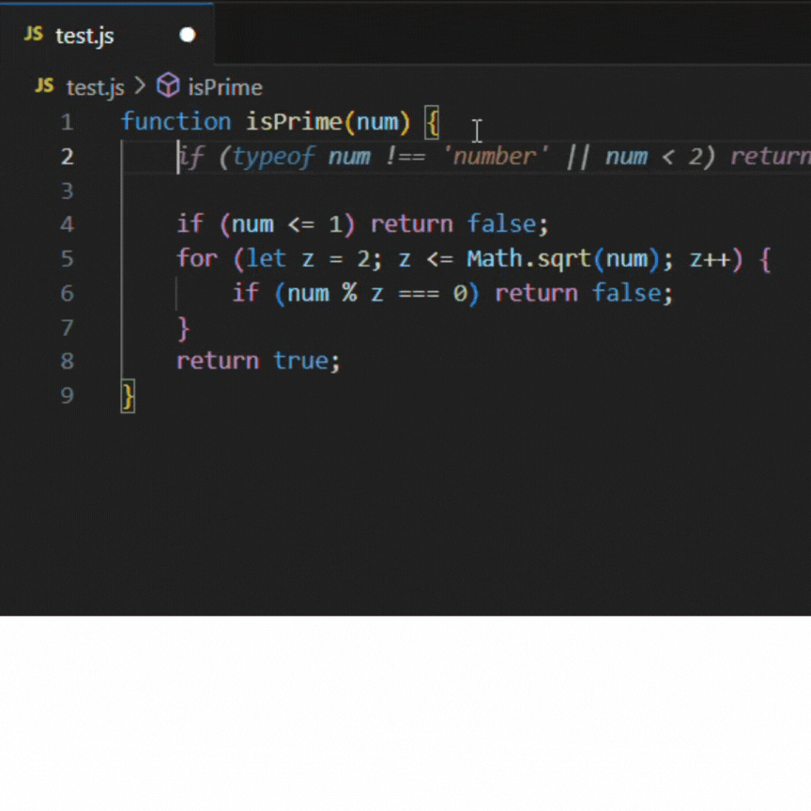
Comments
Natural-language comments will trigger copilot to generate an answer/solution
Write clear and descriptive comments to produce clean and accurate code

Slide 16
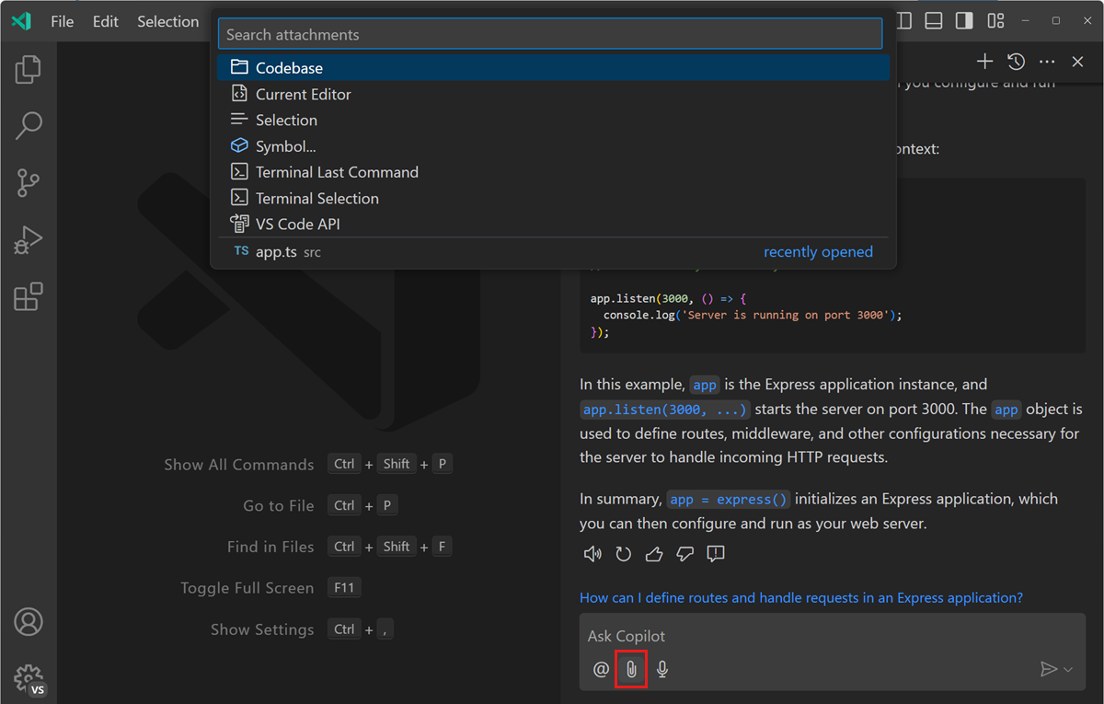
Add Context
Use the add context button to provide copilot with the context of the additional files/ directories.

Slide 17
Setup open-source repo
Link to the open-source repo (can be found in the assignment description on canvas) https://github.com/JeevanRMunn/jsoncrack.com
Setup
Git clone <your repo link>
npm install -g pnpm@latest-10
Pnpm install
Pnpm dev
Editing
Git add
Git commit –m <message>
Git push origin main
Create pull request to original repository https://github.com/ramfam101/jsoncrack.com.git main branch
Use VS Code
Use Copilot

Slide 18
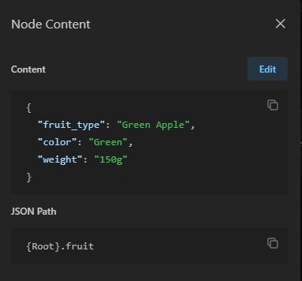
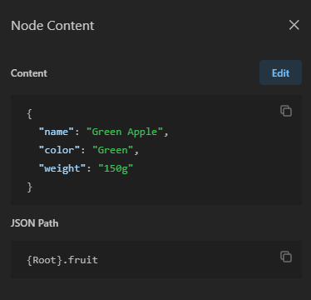
Task is...
Allow users to edit node values directly from the visualization panel.
Add an edit button to nodes in the visualization
Include save and cancel functionality
Edits should be reflected in
Visualization
Left hand side editor
Notes:
This assignment will be using AykutSarac's JSON visualizer, an open-source repository as the general workspace. Using copilot tools, you will be responsible for the task below.
The task here will be to implement a new feature that allows editing of the data of the node shown in the visualization portion of the screen. As editing the data in the editor on the left-hand side of the screen is more complex with bigger JSON's, you are to implement a feature that allows a user to directly edit a node and change the value of specific content or its label. As can be seen in the images to the left, the label and the value for the JSON can be changed for that node. This change should also be reflected in the left-hand sides text editor and maintain the properties of the JSON from before and contain the edits.

Slide 19
You can begin now.....
Make sure to start a Zoom room share your screen and record the session through record on cloud option (at the end you need to share the zoom recording link)
Will let you know when the time is up (60 minutes)

Slide 20
Assignment requirements
Submit a pull request
Export chat
In the VS code window press CTRL + SHIFT + P
Search for 'Chat: Export chat'
Download the chat.json and submit as part of the submission and in Qualtrics.
Push to your branch and make pull request to original repository
Notes:
Add ques in qualtrics to upload chat file

Slide 21
Submission and survey
Pull request link
The chat files
Afte assignment completion, fill out the survey (survey must be done after completing the assignment) https://ufl.qualtrics.com/jfe/form/SV_egkCwijfM8Z6aCa

Slide 22
Survey (https://ufl.qualtrics.com/jfe/form/SV_egkCwijfM8Z6aCa)
The survey aims at understanding how students use Copilot for assistance
Survey will be considered valid if submitted after completing the assignment.
Will receive the extra credit for completing the survey (similar to completing a SONA study)

Slide 23
Thank You

